Slide 1


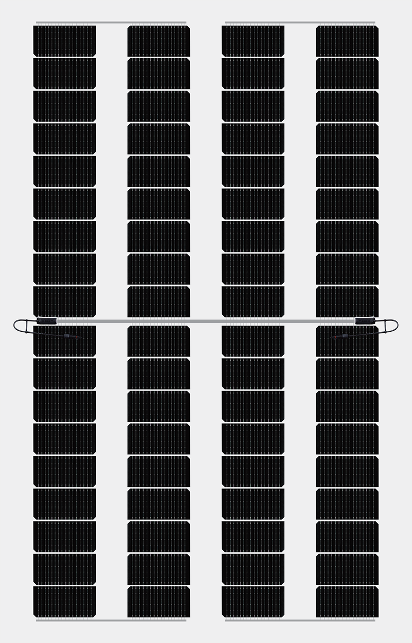











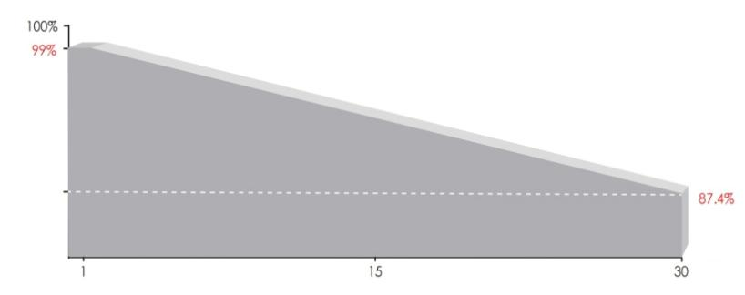
ESM-320 Luminous PV
182mm Double Glass Bifacial Frameless
Luminous Mono Half Cell PV Module
TRANSMITTANCE 45（%）
Module characteristics
SMBB Technology
Half Cut Solar Cell
High Energy
Performance
100% Inspection
30years Guarantee
Fire Class A
Strengthened
Mechanical Load
Advanced Bifacial Efficiency
Long and reliable quality assurance
30 years material and workmanship warranty
30 years power linear warranty
IEC61215(2016), IEC61730(2016) ISO9001:2015: Quality management system ISO14001:2015: Environmental management system ISO45001:2018: Occupational health and safety management system
Power output
1% attenuation for 1st year;
Linear attenuation of 0.4% per year over from the 2nd to 30th year
year

Slide 2
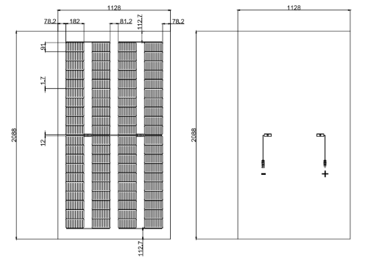
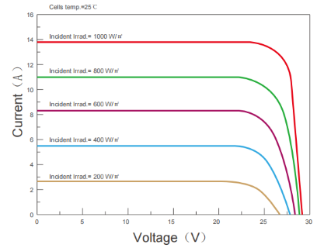

Mechanical Diagrams
Curve
All Dimensions in mm
The above drawing is a graphical representation of the product.
For engineering quality drawings please contact EINNOVA.
Characteritics(STC)
Module Type | SKT320M10
 | STC
MaximumPower-Pmax(W) | 320
Open Circuit Voltage - Voc(V) | 28.12
Short- CircuitCurrent -Isc(A) | 13.77
Voltage atPmax -Vmp(V) | 24.6
Current atPmax -Imp(A) | 13.01
ModuleEfficiency -ηm(%) | 19.55
Power Tolerance(W) | （0，+4.99W）
Maximum System Voltage(V) | 700Vdc (IEC/UL)
Maximum Series Fuse Rating (A) | 25A
STC : Irradiance 1000W/m 2 ，Cell Temperature 25℃, Air Mass 1.5
Mechanical Specifications
Temperature Characteristics
External Dimensions | 2088*1128*5mm
Weight | 27kg
Solar Cells | Mono crystalline 182mm (2x40pcs)
Front Glass | 2+2 mm tempered glass
Frame | No Aluminum
Junction Box | IP67
Output Cables | 4.0mm², 120cm (+), 120cm (-), length can be customized
Connector | MC4 Compatible
Mechanical Load | Front Side Max. 5400Pa, Rear Side Max. 2400Pa
Pmax Temperature Coefficient | -0.290%/°C
Voc Temperature Coefficient | -0.250%/°C
Isc Temperature Coefficient | +0.045%/°C
Operating Temperature | -40～+85°C
Nominal Operating Cell Temperature(NOCT) | 45±2°C
Packing Configuration
EINNOVA SOLARLINE ENERGY CORP. LIMITED
210000 Nanjing
PEOPLE‘S REPUBLIC OF CHINA
TEL：+86-25-8479-2033
Cell: +86-138-13088384
EMAIL : emma.wu@einnova-solarline.com
Website：www.einnova-solarline.com
Product size | 2088*1128*5mm
Container | 20’GP | 40’HQ
PiecesperPallet | 34 | 34
Palletsper Container | 6 | 26
The company reserves the right of final right of adjustment of this file.

